Slide 1
Computer Networks
CSE405
Data Link Layer
Rabea Khatun
Lecturer
Dept. Of CSE
East West University

Slide 2
Binary exponential backoff in CSMA/CD
Binary exponential backoff refers to a collision resolution mechanism used in random access MAC protocols. This algorithm is used in Ethernet wired LANs. In Ethernet networks, this algorithm is commonly used to schedule retransmissions after collisions.
Randomization after collision

Slide 3
Binary Exponential Backoff
After a collision, time is divided into discrete slots whose length is equal to 2τ, where τ is the maximum propagation delay in the network.
The reason for this choice is that 2τ is the minimum amount of time a source needs to listen to the channel to always detect a collision.
The stations involved in the collision randomly pick an integer from the set {0,1}. This set is called the contention window.
If the sources collide again because they picked the same integer, the contention window size is doubled and it becomes {0,1,2,3}. Now the sources involved in the second collision randomly pick an integer from the set {0,1,2,3} and wait that number of slot times before trying again.
The station that picks the smallest integer in the window gets the earliest transmission opportunity.
‏

Slide 4

Binary Exponential Backoff
In general, after i collisions, a random number between 0 and $2^{i}−1$is chosen.
After a station detects collision, it aborts its transmission in the slot duration itself in which it started transmitting.
In Ethernet, the doubling of the contention window stops after 10 collisions and the contention window remains {0,1,...,1023}.
After 16 collisions , the process is aborted and the source stops trying.
‏

Slide 5
Collision with two sources
Assuming two sources are involved in collision
Source S1
Time
Source S2
Time

Slide 6
Collision with two sources
Assume first collision took place
The initial contention window for two sources is {0, 1}
Source S1
C W: {0, 1}
Time
Source S2
CW: {0, 1}
Time

Slide 7
Collision with two sources
After a collision, time is divided into discrete slots.
Frame length is much larger than the slot size.
A single slot is sufficient to detect a collision.
Source S1
0 1 2 3 4 5 6 7 8
CW :{0,1}
Time
Source S2
0 1 2 3 4 5 6 7 8
CW: {0,1}
Time

Slide 8
Collision with two sources
Ideal case that S1 and S2 picks different slots randomly for the transmission of the frame.
Suppose S1 picks 0 and S2 picks 1, S1 starts sending the frame in slot 0 S2 should start sending the frame in slot 1 but it hears the channel is busy and waits till the channel is free.
Source S1
0 1 2 3 4 5 6 7 8
CW :{0,1}
Time
Source S2
0 1 2 3 4 5 6 7 8
CW :{0,1}
Time

Slide 9
Collision with two sources
Suppose S1 and S2 picks the same slot number 0 to transmit the frame, they collide again.
After second collision, the contention window changes to {0,1,2,3}
Source S1
0 0 1 2 3 4 5 6 7
CW: {0,1,2,3}
Time
Collision occurs
Source S2
0 0 1 2 3 4 5 6 7
CW: {0,1,2,3}
Time

Slide 10
Collision with two sources
Suppose S1 and S2 picks the same slot number 2 to transmit the frame, they collide again.
After third collision, the contention window changes to {0,1,2,3,4,5,6,7}
After 16 such attempts of transmission, the process is aborted.
Source S1
0 0 0 1 2 3 4 5 6
CW: {0,1,2,3,4,5,6,7}
Time
Collision occurs
Source S2
0 0 0 1 2 3 4 5 6
CW: {0,1,2,3,4,5,6,7}
Time

Slide 11
Collision with three sources
Source S1
Time
Source S2
Time
Source S3
Time

Slide 12
Collision with three sources
Assume first collision took place
The initial contention window for three sources is {0, 1}
Source S1
CW: {0,1}
Time
Source S2
CW: {0,1}
Time
Source S3
CW: {0,1}
Time

Slide 13
Collision with three sources
After a collision, time is divided into discrete slots.
Frame length is much larger than the slot size.
A single slot is sufficient to detect a collision.
Source S1
0 1 2 3 4 5 6 7 8
CW: {0,1}
Time
Source S2
0 1 2 3 4 5 6 7 8
CW: {0,1}
Time
Source S3
0 1 2 3 4 5 6 7 8
CW: {0,1}
Time

Slide 14
Collision with three sources
Suppose S1 and S2 picks the same slot number 0 to transmit the frame and S3 picks 1, then S1 and S2 collide again.
After second collision, the contention window changes to {0,1,2,3}
The contention window of S3 remains same.
Source S1
0 1 2 3 4 5 6 7 8
CW: {0,1,2,3}
Time
Source S2
0 1 2 3 4 5 6 7 8
CW: {0,1,2,3}
Time
Source S3
0 1 2 3 4 5 6 7 8
CW: {0,1}
Time

Slide 15
Collision with three sources
Suppose S1 picks slot number 0 to transmit the frame after second collision and S3 picks 1 after first collision and S2 picks 3 after second collision, then S1 and S3 collide again.
After third collision, the contention window of S1 changes to {0,1,2,3,4,5,6,7}
After second collision, the contention window of S3 changes to {0,1,2,3}
Source S1
0 0 1 2 3 4 5 6 7
CW: {0,1,2,3,4,5,6,7}
Time
Source S2
0 0 1 2 3 4 5 6 7
CW: {0,1,2,3}
Time
Source S3
0 1 2 3 4 5 6 7 8
CW: {0,1,2,3}
Time

Slide 16

CSMA Problems in Wireless Medium
Collision detection is easy in wired networks but difficult in wireless medium.
Collision avoidance to reduce wasted transmissions
Transmission
Range of S
R
S

Slide 17
CSMA Problems in Wireless Medium
With only one antenna/radio, nodes can only listen or send.
Full duplex radios are extremely expensive.
CSMA gives rise to hidden terminal and exposed terminal problems.

Slide 18
Collision Avoidance (CA)
CSMA/CD assumes stations can detect collision.
Not valid in all contexts (e.g., wireless):
– Attenuation too great to detect collision at all stations.
– Hard for transmitter to distinguish its own transmission from incoming weak signals and noise.
– Radios are usually half-duplex.
CSMA/CA tries to avoid collisions.
It also uses collision avoidance techniques such as interframe spacing, contention windows, and acknowledgments to reduce the chances of collisions.

Slide 19
How CSMA/CA Works?
1. Sense the Medium (Carrier Sensing - "Listen Before Talk")
The sending station (source node) first listens to check if the wireless channel is idle (not in use).
If the channel is busy, the station waits until it becomes free.
If the channel is idle, the station waits for a specific period called DCF Interframe Space (DIFS) before proceeding.
DCF Interframe Space (DIFS) is a mandatory waiting period in the Distributed Coordination Function (DCF) of IEEE 802.11 wireless networks. It is the time interval a station must wait after sensing the channel as idle before it can attempt transmission. This prevents multiple devices from transmitting immediately, reducing the chances of two or more devices sending data at the same time (which would cause a collision).
DIFS Calculation and Values
DIFS is calculated using the formula:
DIFS=SIFS+(2×Slot TimeWhere:
SIFS (Short Interframe Space) is a small waiting time for high-priority messages like ACKs.
Slot Time is a fixed time unit depending on the wireless standard.

Slide 20
How CSMA/CA Works?
2: Wait for a Random Backoff Time (Contention Window)
After waiting for DIFS, the station does not transmit immediately.
Instead, it waits for a random backoff time within the Contention Window (CW).
The backoff time is chosen randomly and decreases only when the channel remains idle.
If the channel becomes busy during this waiting period, the backoff timer is paused and resumes once the channel is idle again.
3: Start Transmission
Once the backoff timer reaches zero, the station begins data transmission.
The station sends the data packet to the receiving station.
4: Short Interframe Space (SIFS) & Acknowledgment (ACK)
After receiving the data packet, the receiver (destination node) waits for a Short Interframe Space (SIFS).
Then, the receiver sends an ACK (Acknowledgment) packet back to the sender.

Slide 21
How CSMA/CA Works?
5: Handling Collisions (Binary Exponential Backoff)
If the sender does not receive an ACK, it assumes a collision occurred.
The sender then doubles the contention window (CW) size and selects a new random backoff time.
The sender repeats the process (starting from Step 2) until successful transmission occurs.

Slide 22


CSMA/CA
Tries to avoid collisions by avoiding the
“hidden terminal” problem.

Slide 23
Hidden Terminal Problem
Other senders’ information are hidden from the current sender, so that transmissions at the same receiver cause collisions.
Stations in a wireless network have a limited range, so that it could be that participants in a network don’t even recognize each other.
It is conceivable, but not improbable, for two stations not to recognize one another, but to want to simultaneously reach a station that is located between them. Transmissions can overlap at the receiving node, meaning data gets lost. Both transmitters do not detect the collision and don’t start a new delivery attempt. CSMA/CA alone cannot solve this problem, which is why an optional extension was created: RTS/CTS (“Request to Send” and “Clear to Send”).
R
S1
S2

Slide 24
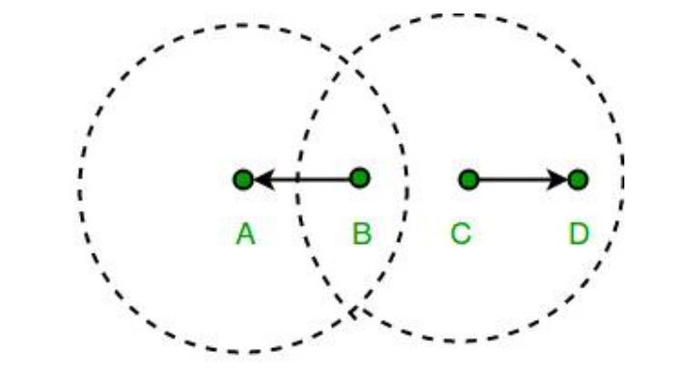
Exposed Terminal Problem
The exposed terminal problem occurs in wireless networks when a station unnecessarily defers transmission because it senses another nearby transmission, even though its transmission would not cause interference. This reduces network efficiency.

Slide 25
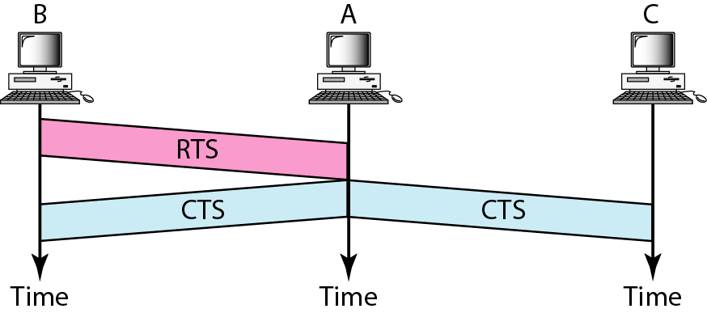
CSMA/CA:RTS-CTS Solution
“Channel Reservation”
With collision avoidance, stations exchange small control packets to determine which sender can transmit to a receiver

Slide 26
CSMA/CA:RTS-CTS Solution
Hidden terminal problem Solution
How RTS/CTS Solves It?
Step 1: A wants to send data to B, so it sends an RTS (Request to Send) to B. Step 2: B responds with CTS (Clear to Send). Step 3: When C hears B’s CTS, it knows B is busy and does not transmit. Step 4: A successfully transmits the data without collision.
Since B broadcasts CTS, all nearby stations (including C) become aware of the ongoing transmission and avoid sending data.
R
S1
S2

Slide 27
CSMA/CA:RTS-CTS Solution
Exposed terminal problem Solution
How RTS/CTS Solves It?
Step 1: C sends RTS (Request to Send) to D. Step 2: If D responds with CTS (Clear to Send), C knows that its transmission will not interfere with B. Step 3: C transmits its data to D without unnecessary delay.
The CTS message ensures that C knows transmission is safe, preventing unnecessary waiting.

Slide 28
Contention/ Collision Free Protocols

Slide 29
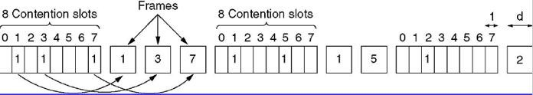
Multiple Access Protocols:
CSMA without Contention:
A Bit-Map Protocol
Each contention period consists of exactly N slots.
In general, station i inserts 1 in time slot i in ordert to send data.
After all N slots have passed by, each station has complete
knowledge of which stations wish to transmit. Then they begin transmitting in numerical order. Since everyone agrees on who goes next, there will never be any collisions.
After the last ready station has transmitted its frame, another N bit contention period is begun.

Slide 30
Multiple Access Protocols:
CSMA without Contention: A Bit-Map Protocol
Performance analysis: Assume data frames consisting of d time units where one time unit is one contention bit slot.
The mean delay for all stations is N slots.
The efficiency:
At low load: The overhead per frame is N bits, and the amount of data is d bits, for an efficiency of d/(N + d).
At high load: When all the stations have something to send all the time, the N bit contention period is distributed over N frames, yielding an overhead of only 1 bit per frame, or an efficiency of d/(d + 1).

Slide 31
Multiple Access Protocols:
CSMA without Contention: A Bit-Map Protocol
Example: Efficiency at Low Load (Few Active Stations)
Suppose N = 8 stations and each station sends d = 1000 bits of data.
Efficiency = 1000 / (8 + 1000) = 1000 / 1008 ≈ 99.2%
If N is large, efficiency decreases because more bits are wasted in contention slots.
Example: Efficiency at High Load (All Stations Sending Data)
If d = 1000 bits, efficiency = 1000 / (1000 + 1) ≈ 99.9%
As d increases, efficiency approaches 100% because overhead becomes negligible.

Slide 32
Multiple Access Protocols:
CSMA without Contention: Token Passing
Token passing
The token represents permission to send.
If a station has a queued frame when it receives the token, it can send that frame before it passes the token to the next station.
If a station has no queued frame, it simply passes the token
Two kinds of token passing
Token ring
Token bus

Slide 33
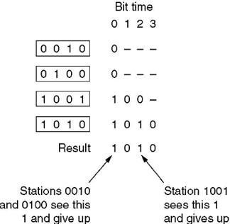
Multiple Access Protocols:
CSMA without Contention: Binary Countdown
The binary countdown protocol.
A dash indicates silence.

Slide 34
Multiple Access Protocols:
CSMA without Contention: Binary Countdown
A station wanting to use the channel now broadcasts its address as a binary bit string, starting with the high-order bit. All addresses are assumed to be the same length.
The bits in each address position from different stations are BOOLEAN ORed together by the channel when they are sent at the same time.
To avoid conflicts, an arbitration rule must be applied: as soon as a station sees that a high-order bit position that is 0 in its address has been overwritten with a 1, it gives up.

Slide 35
Multiple Access Protocols:
CSMA with Limited-Contention
With Contention method
Under low load, the contention method (i.e., pure or slotted ALOHA, CSMA) is preferable due to its low delay.
Under high load, the contention method becomes increasingly less efficient.
Without Contention method
Under low load, the collision-free method has high delay.
Under high load, the collision-free method becomes increasingly more efficient.
→ Limited-Contention Protocols

Slide 36
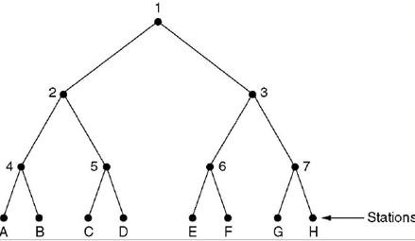
Multiple Access Protocols:
CSMA with Limited-Contention
Adaptive Tree Walk Protocol
At first , all stations that want to transmit send a contention signal.
If there is no collision, the successful station transmits.
If a collision occurs, the protocol splits the stations into groups (left and right branches of a tree).
The stations are divided into two groups (left and right subtree).
The left group tries to transmit first.
If there is a collision, the left group is further divided into subgroups, and the process repeats.
Once the left group is resolved, the protocol moves to the right group.
Adaptive Behavior
If the network load is low, all stations can contend together.
If the load is high, the tree-based approach efficiently reduces contention, limiting collisions.

